Slide 1
UNIT-2
Agile Team Dynamics and Collaboration

Slide 2
Table of Content
What is Agile team dynamics and collaboration.
Building and managing cross-functional teams.
Different roles in an Agile team.
Product Owner.
Scrum Master
Fostering Collaboration in Agile Teams

Slide 3
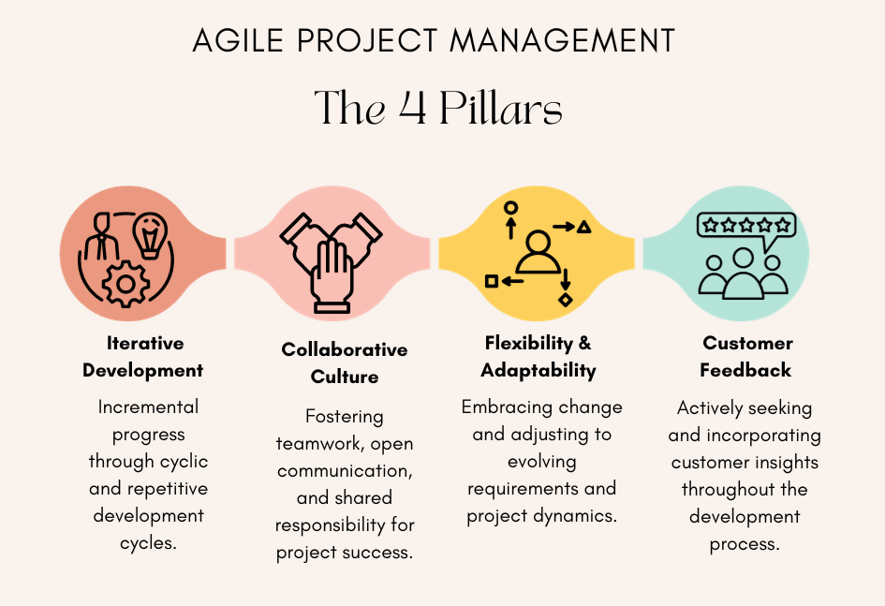
What is Agile team dynamics and collaboration.
It is the core of Agile methodologies.
To Building and managing cross-functional teams.
By understanding roles like Product Owner and Scrum Master, and fostering.
Collaboration are crucial for successful Agile project execution.

Slide 4
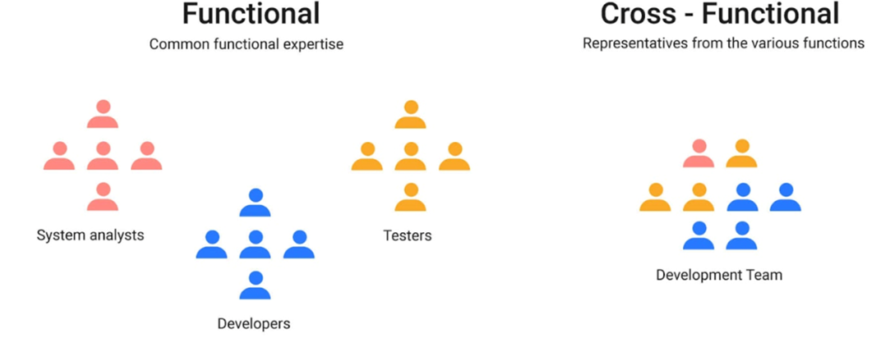
Building and Managing Cross-Functional Teams
Cross-Functional Teams:
Composed of individuals with diverse
skill sets.
Key Principles:
Self-Organizing.
Empowered.
Challenges:
Balancing workloads across
diverse skill sets.
Strategies for Success:
Foster psychological safety to
encourage idea sharing.

Slide 5
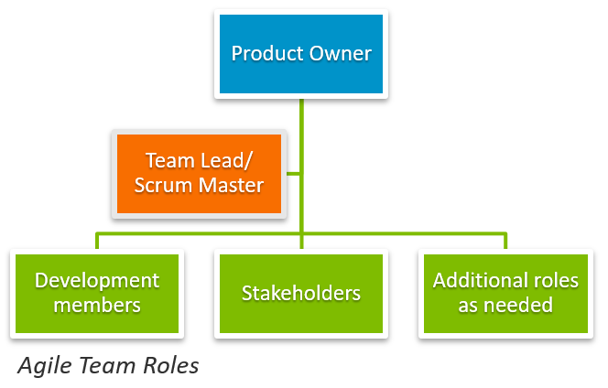
Different Roles in an Agile Team
1. Product Owner:
Responsibilities:
Define and prioritize the product backlog.
Key Skills:
Strong communication and negotiation abilities.
Best Practices:
Maintain a transparent and
well-prioritized backlog.

Slide 6
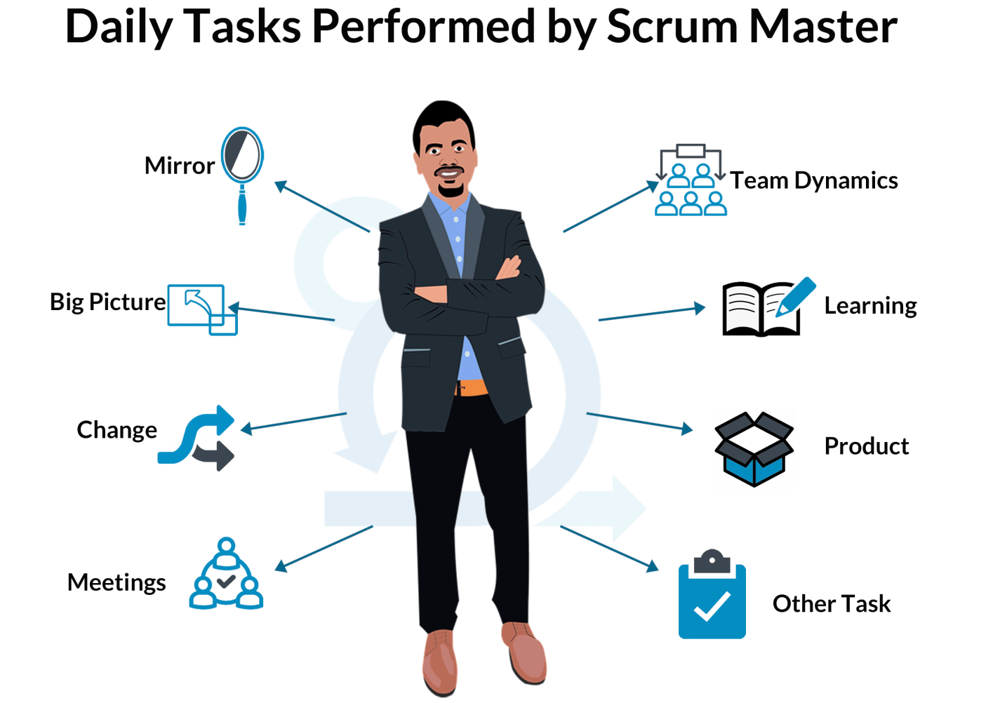
Different Roles in an Agile Team
2. Scrum Master:
Responsibilities:
Remove impediments that
block the team's progress.
Key Skills:
Strong facilitation and
conflict-resolution skills.
Best Practices:
Act as a servant-leader,
focusing on team success.

Slide 7

Different Roles in an Agile Team
3. Team Members:
Responsibilities:
Collaborate to deliver high-quality, incremental product improvements.
Key Skills:
Technical expertise relevant to their role.

Slide 8
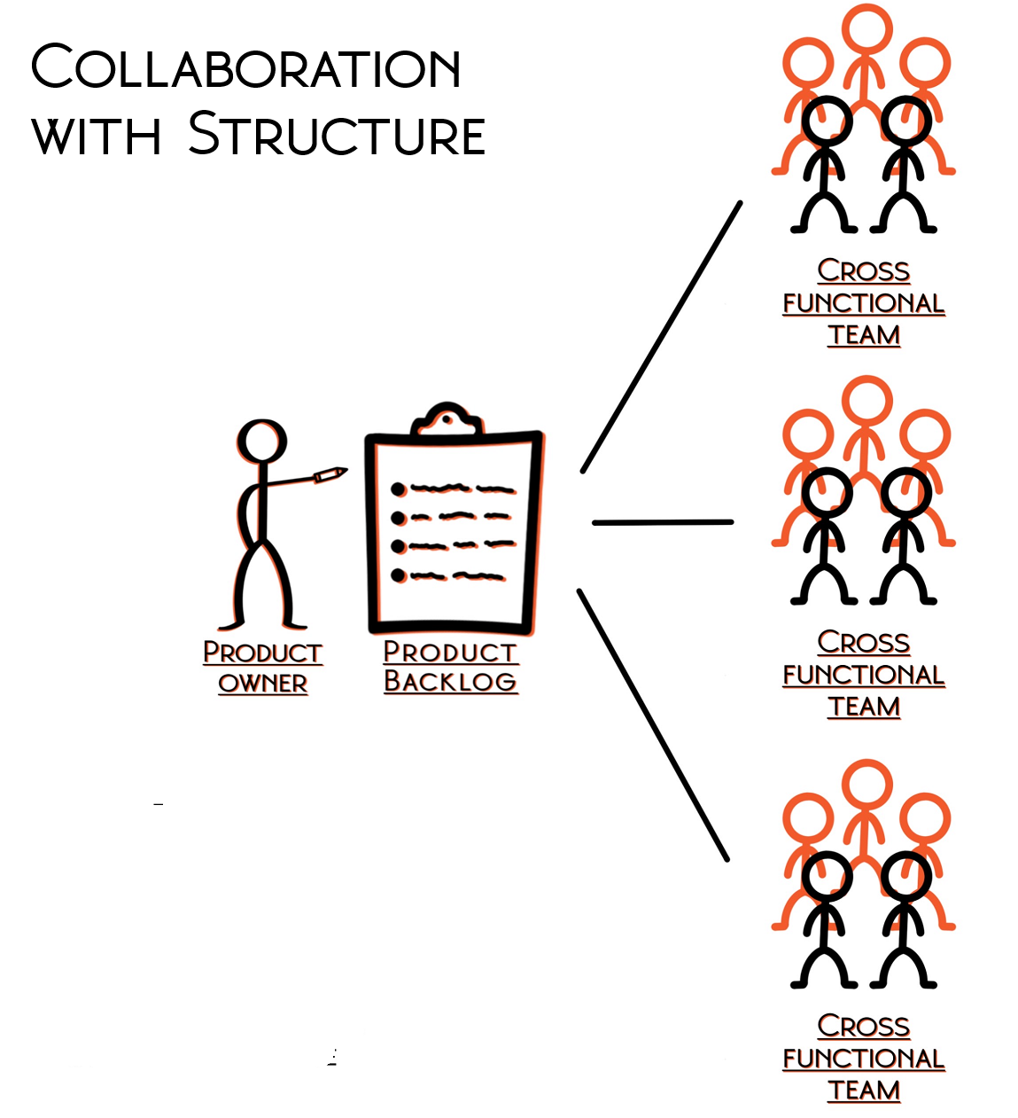
Fostering Collaboration in Agile Teams
Daily Stand-Ups:
Encourage transparency on progress,
blockers, and next steps.
Collaboration Tools:
Use platforms like Jira, Trello, or Slack for
task tracking and communication.
Feedback and Retrospectives:
Regular retrospectives foster a culture of
continuous improvement.
Shared Vision:
Celebrate small wins to maintain
motivation.

